Slide 1




Rx for Insight:
Analyzing Medicare Part B Drug Spending
μ Girls
Rani Misra
Cheryl Chiu
Kashfia Sharmin
Abigail Davis
Notes:
We did our presentation on Medicare Part B Spending

Slide 2

Introduction
What is Medicare?
59,482,817 beneficiaries as of 2022
Age 65+, Disabled, or End-Stage Renal Disease
Medicare Part B
Premiums
Doctor’s offices or other outpatient settings
Goals of this study
Lower Costs of IgG drugs
Change Medicare policies
IgG
Notes:
As of 2022, a total of 59,482,817 beneficiaries are enrolled in the Medicare Part B program which is a voluntary program that impacts healthcare coverage for Americans who are age 65 and older, disabled, or have End-Stage Renal Disease (ESRD). Our analysis will focus specifically on Immune Globulin or (IgG) drugs for beneficiaries assessing how Part B’s coverage and premiums impact these beneficiaries’ and their access to these medications.
By focusing on the spending metrics, our study aims to provide recommendations to the Centers for Medicare and Medicaid services or CMS to reduce the financial burden to beneficiaries for high-cost drugs, while ensuring the program’s sustainability.

Slide 3

Our Data
Medicare Part B Spending by Drug
Collected by the Centers for Medicare and Medicaid Services (CMS)
Immune Globulin (IgG) subset
363,092 Medicare beneficiaries
Best-selling drugs in the pharmaceutical market
Key Metrics
Spending, dosage, claim, beneficiaries 2018-2022
Notes:
For this study, we did an analysis of the ‘Medicare Part B Spending by Drug’ data set, which was collected by CMS, includes information on drug spending by doctors’ offices and other outpatient settings to Part B beneficiaries.We calculated an IgG drug subset using SAS finding that 363,092 beneficiaries that have utilized these drugs between 2019-2022. According to researchers, the market for therapeutic antibody drugs, such as IgG, have become the best-selling drugs in the pharmaceutical market due to approval by the FDA to treat many diseases such as cancers, autoimmune deficiencies, metabolic and infectious diseases. The key metrics we utilized is total spending, dosage, claims, and beneficiaries.

Slide 4



Our problem
How has Medicare Part B spending on IgG drugs changed over the 5-year period of 2018-2022?
Are there particular IG drugs with consistently high or increasing total spending?
Could doctors begin to prescribe generic versions of brand name drugs?
Notes:
The objective of this study is to better understand how Part B spending on IgG drugs has changed over the five-year period. Are there particular IgG drugs with consistently high or increasing total spending? Why is this? Could doctors begin to prescribe generic versions of brand name drugs? Addressing these questions is critical for understanding the economic impact of IgG therapies for Part B beneficiaries and offers opportunities for advising CMS of potential areas for cost reduction and policy development.

Slide 5
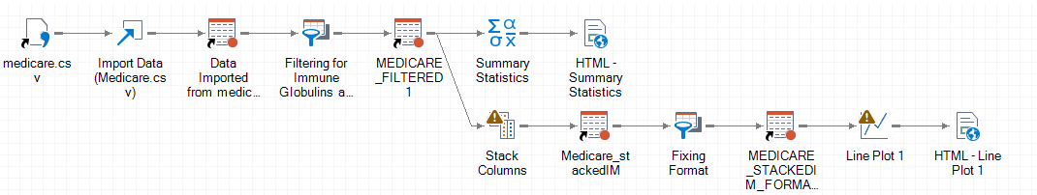
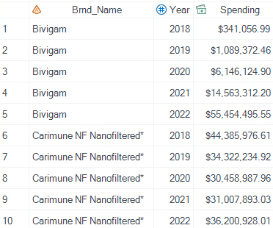
Data Cleaning
Import Data Task
Filter for IgG and non-missing data
26 observations
Stacking and Grouping
stacked by total spending years and grouped by brand name
Formatting
Formatted Year (Only show year) and Spending (DOLLAR 17.2)
Notes:
To begin our analysis, the data was imported by using the ‘Import Data’ task. The resulting data set (called Medicare_Filtered) has 26 observations after filtering for ‘Immune Globulin’ in the description column and only keeping non-missing data based on the ‘Total Spending’ values. Columns were stacked by total spending years and grouped by brand names for easier analysis and interpretation, resulting in a data set with 105 observations (in a data set called Medicare_Stacked). With the stacked data, the format of year was altered to remove unnecessary prefixes. For the Spending column, the appropriate currency format was applied. These steps resulted in a data set which will be referred to as Medicare_Stacked_Formatted.

Slide 6
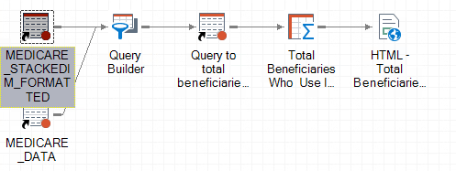
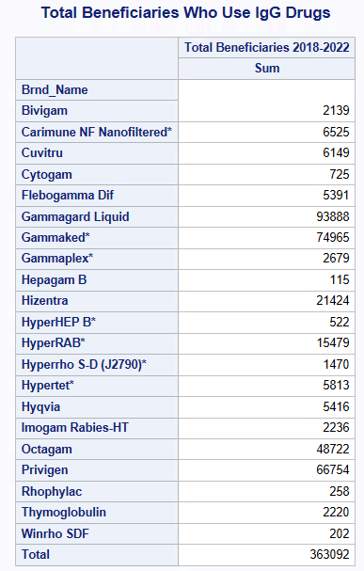
Total Beneficiaries Who Use IgG Drugs
Calculated Column: Total Beneficiaries
Tot_Benes 2018 + Tot_Benes_2019 + Tot_Benes_2020 + Tot_Benes_2021 + Tot_Benes_2022
Group By
Brnd_name
Resulting Summary Table
Total Beneficiaries Who Use IgG Drugs
Total: 363,092 beneficiaries
Notes:
Using our formatted data set, we calculated total number of Medicare beneficiaries from 2018-2022 that utilized IgG drugs. Then we used Query Builder to create a computed column called ‘Total Beneficiaries’ by summing the ‘Tot_Benes_’ from 2018-2022 and grouping the data by the Brnd_name which ensured the data only included the IgG drugs. This resulted in a table (Total_Beneficiaries) and from this table, we created a summary table called ‘Total Beneficiaries Who Use IgG Drugs’ which yielded a total of 363,092 beneficiaries.

Slide 7
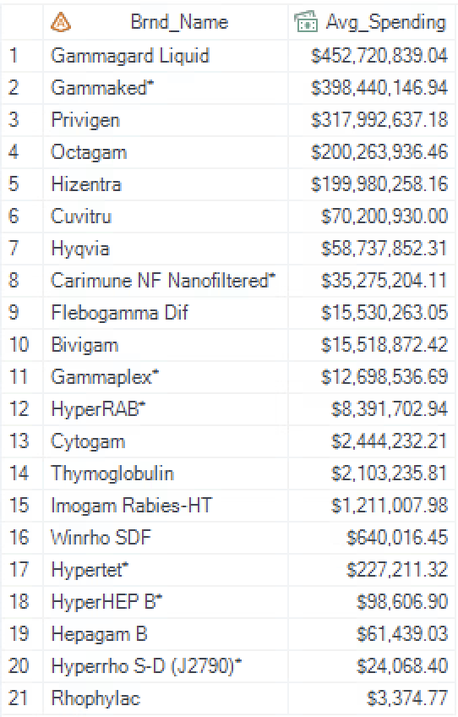
Brands and their Average Spending
Average of Spending per Brand
Sorted in descending order
Top 5 used for forecasting analysis:
Gammagard Liquid, Gammaked*, Privigen, Octagam, and Hizentra
Notes:
Next, the forecast trends for the top five brands with the highest average spending was created. To find these brands, PROC SQL was used to create a table called Brand_Avg_Spending, which included the mean of Spending, and then grouped by Brnd_Name, and sorted in descending order using PROC SORT. Brand_Avg_Spending presented Gammagard Liquid, Gammaked*, Privigen, Octagam, and Hizentra as the brands with the highest average spending from 2018-2022.

Slide 8
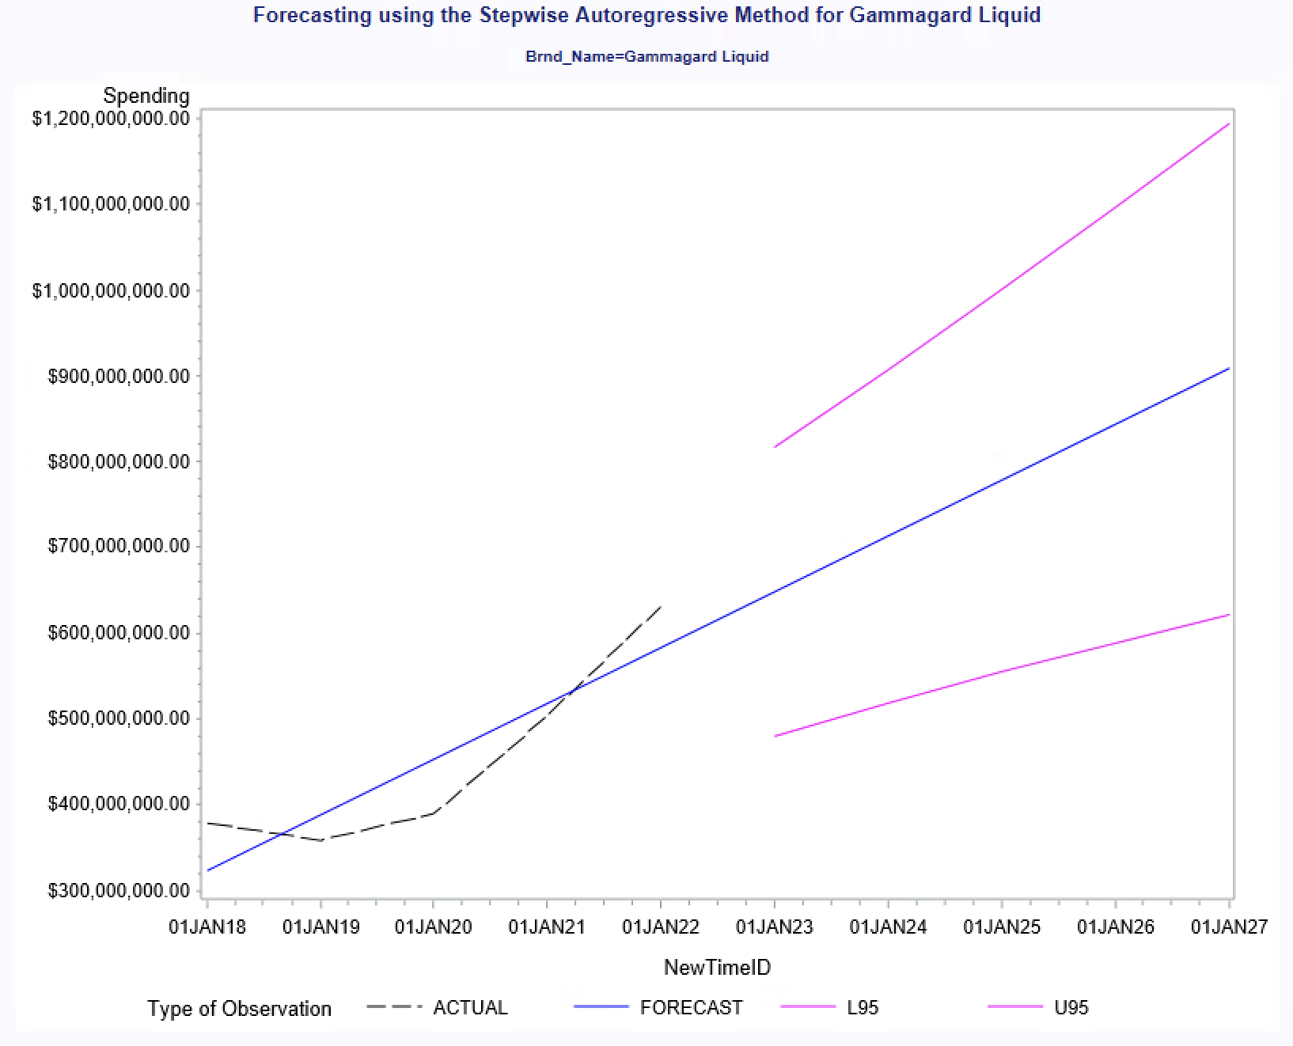
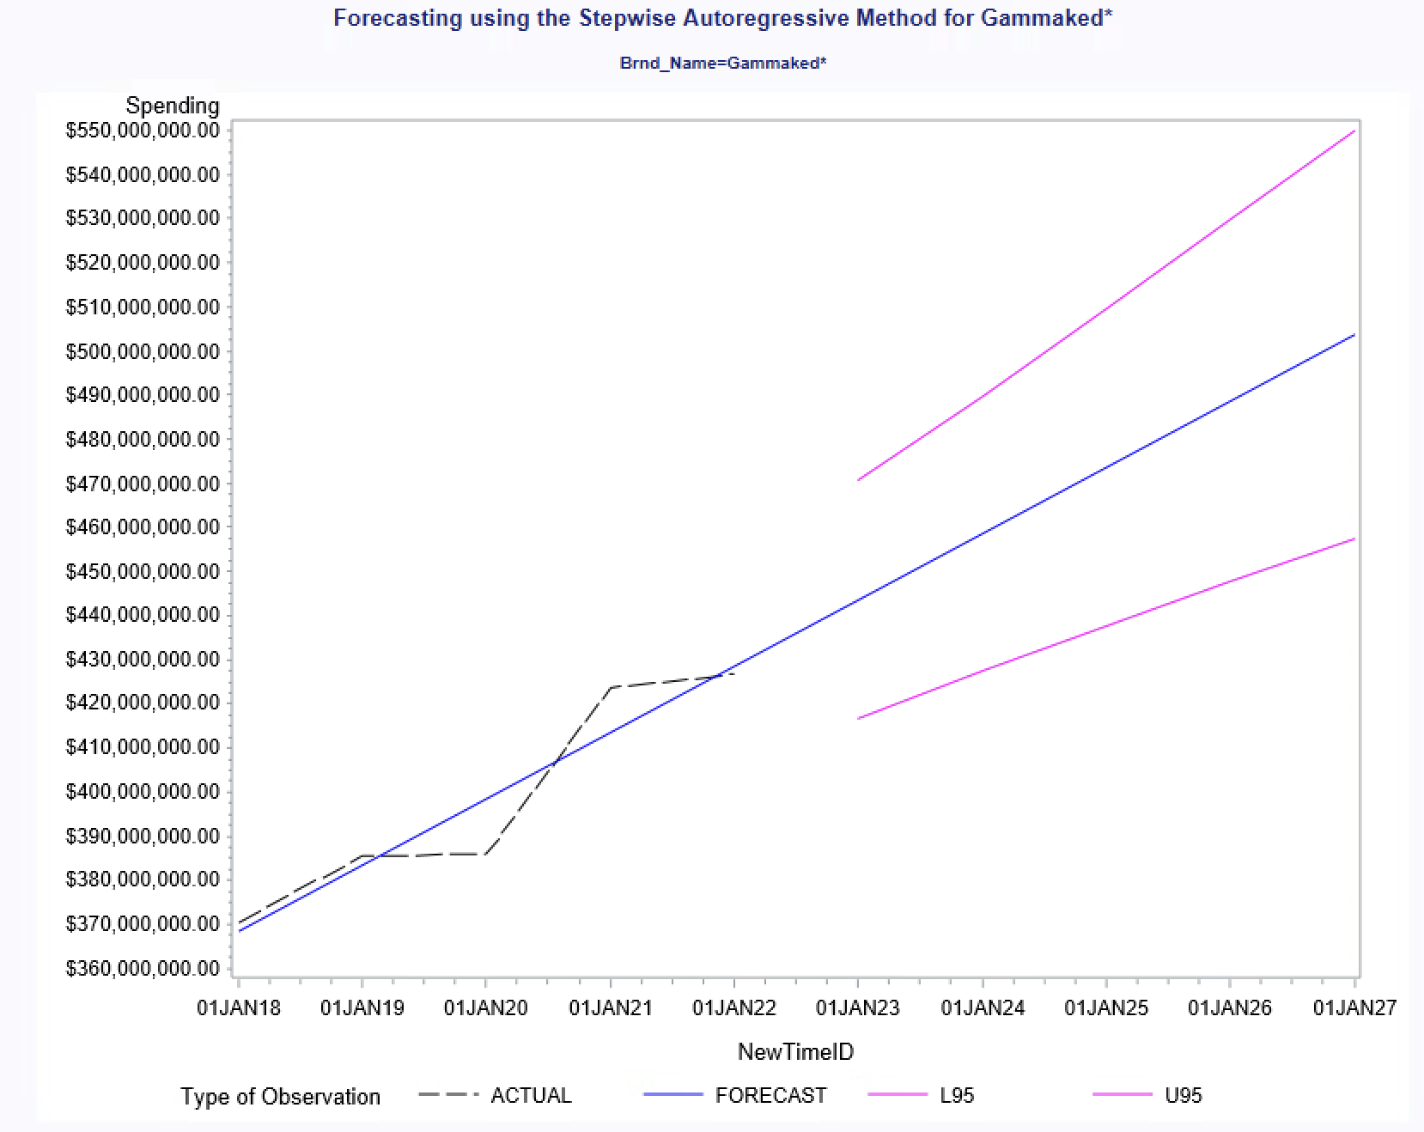
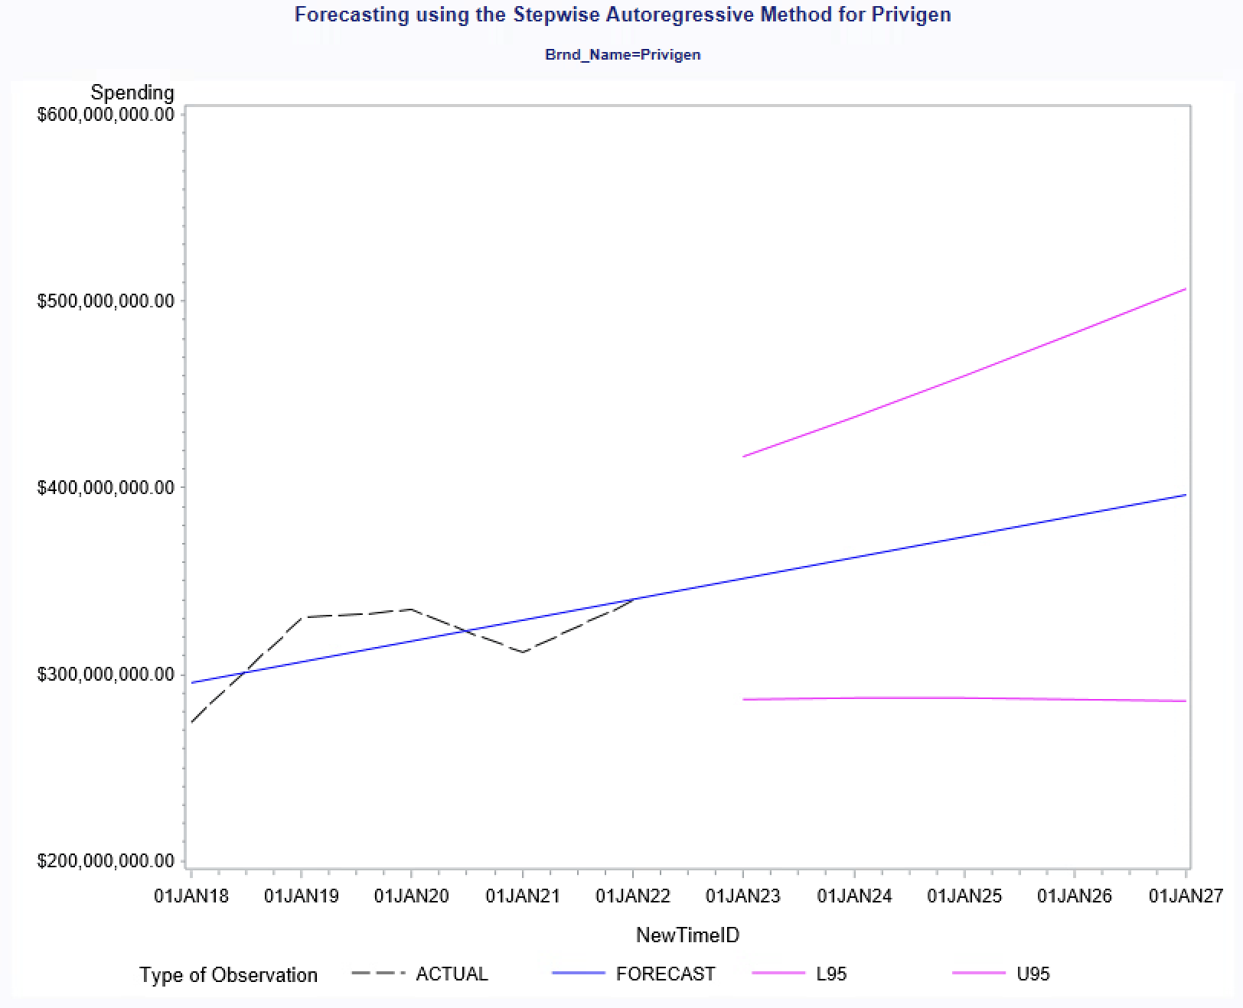
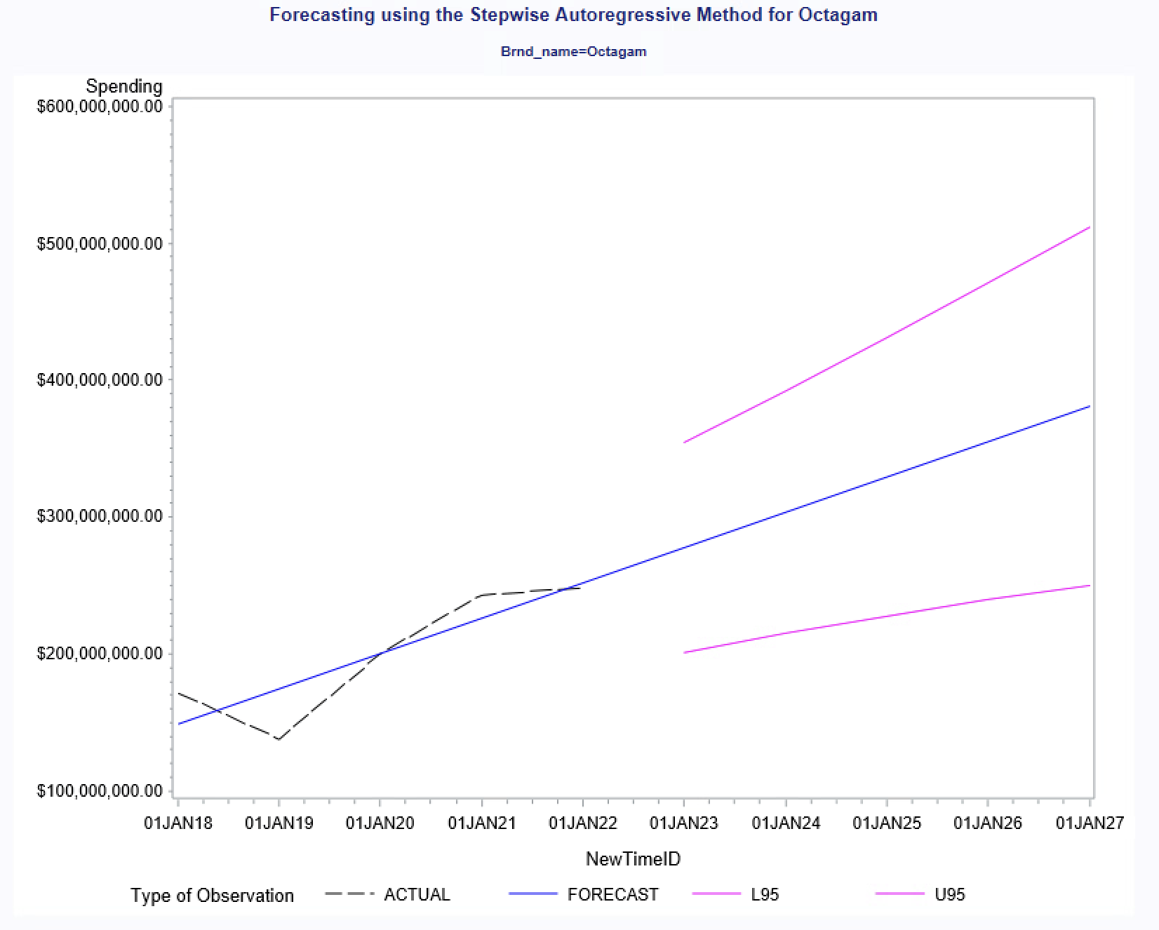
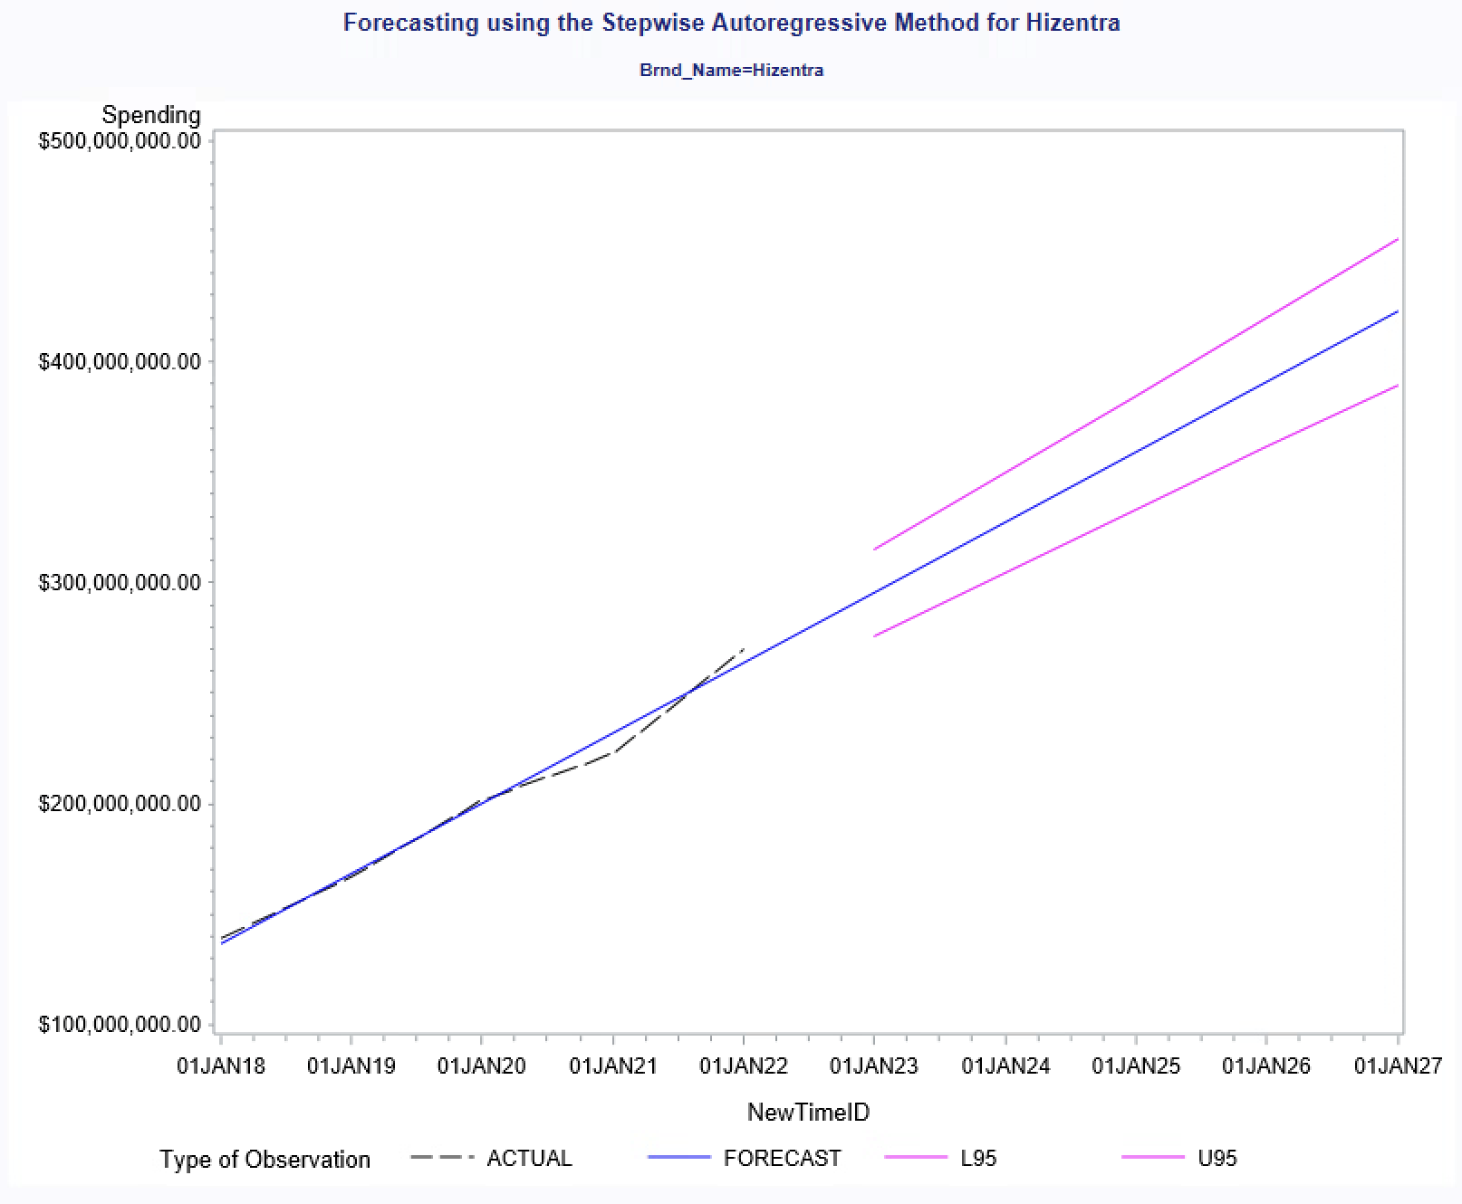
Forecasting
Notes:
A forecast was created for each of the top five brands detected by Brand_Avg_Spending using the Basic Forecasting task. As only five observations were present per Brnd_Name, the forecast generated was not distinct or reliable enough for accurate predictions. However, one can assume that the general upward trend represented by the blue line marked in the graphs, is a reliable outcome given the shortage of plasma supply after the COVID-19 pandemic. Plasma supply is critical in the creation of IgG drugs as they rely on plasma by-products to be manufactured (Hartmann & Klein, 2020).

Slide 9
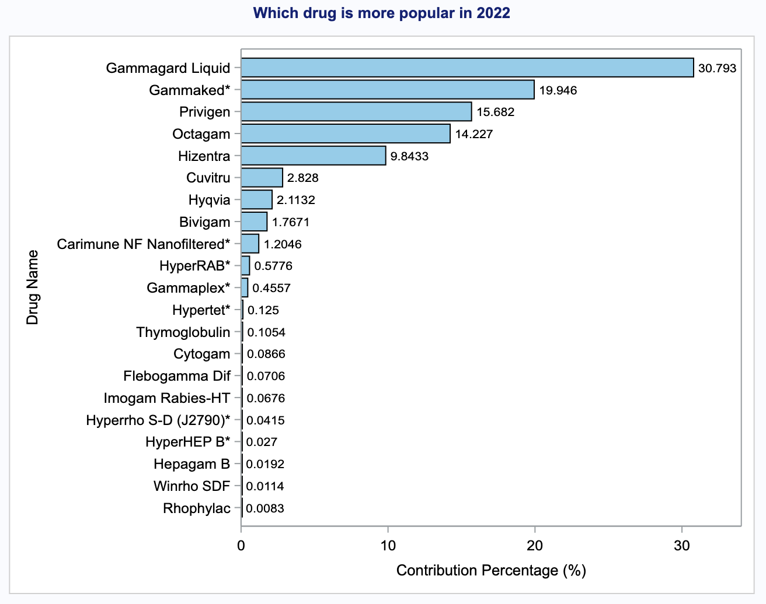
Identifying high-demand IgG drugs in 2022
Policy interventions targeting these high-demand drugs can result in substantial cost savings for CMS and their beneficiaries.
Notes:
As we mentioned earlier, we are interesting in the economic impact of IgG drugs. To understand the contributions of each drug to the IgG market, we calculated the claim percentage for each drug and arranged them in descending order. From this analysis, we identified that [---------] accounted for the highest usage in 2022. Based on these findings, we suggest that interventions and strategies should focus on addressing the demand for these high-demand drugs to optimize market management and patient care.
Gammagard Liquid (31%) Gammaked (20%) Privigen (16%) Octagam (14%) and Hizentra (10%) accounted for the most in 2022

Slide 10
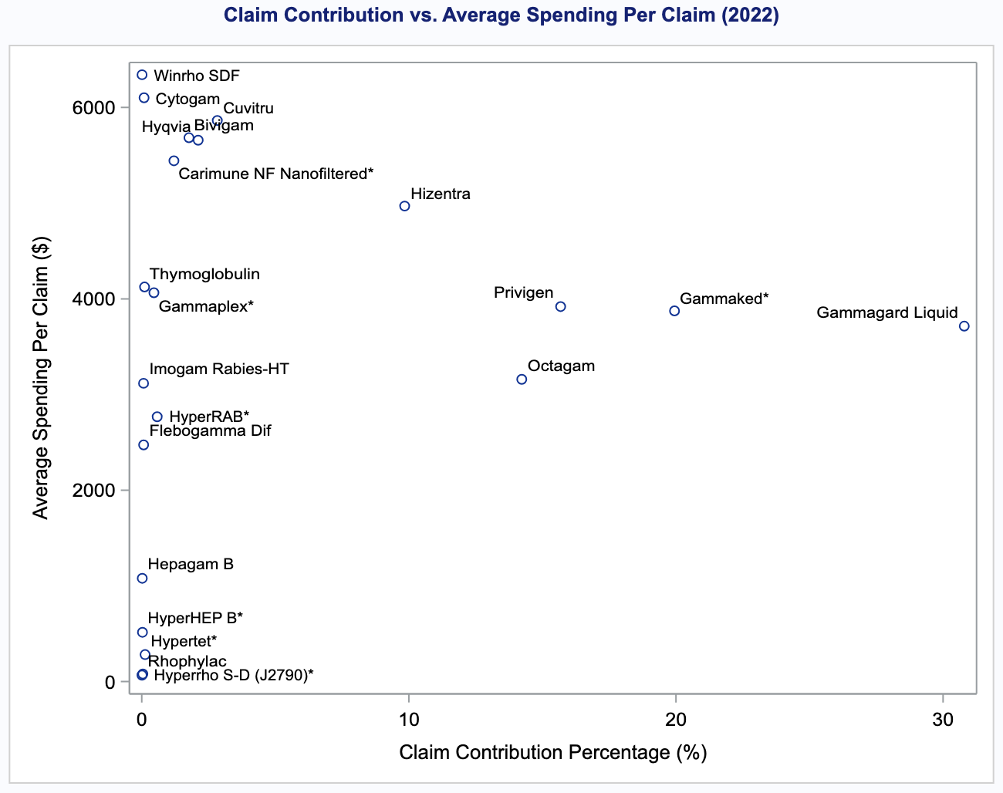
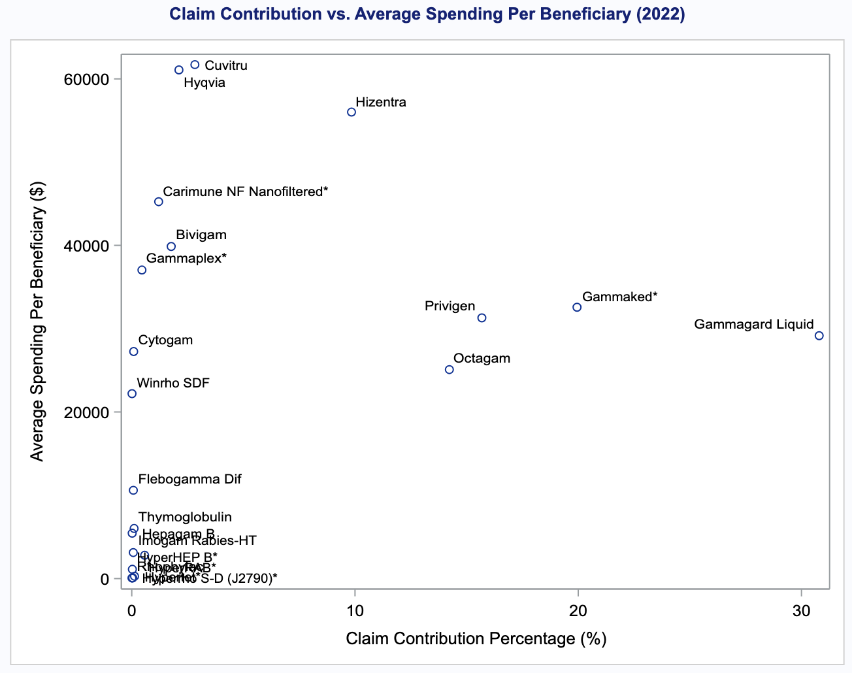
Spending patterns of both beneficiaries and CMS
low-demand
high-cost
high-demand
high-cost
low-demand
high-cost
high-demand
high-cost
High-demand/high-cost and low-demand/high-cost drugs were identified.
Notes:
To analyze spending patterns in the IgG market, we plotted claim contribution percentages against average spending per claim (left) and per beneficiary (right). This visual comparison [animation] highlights high-demand/high-cost and low-demand/high-cost drugs. Drugs in high-demand/high-cost area indicates their significant financial impact on both beneficiaries and CMS.
Here we found an interesting point, the average cost per beneficiary is markedly higher than the cost per claim for Medicare, suggesting a discrepancy where patients may end up paying more out-of-pocket. To investigate this further, we plan to perform a ratio analysis that examines the cost-sharing structure, providing insights into whether Medicare policies are adequately designed to support beneficiaries in managing these high expenses.
Note: Mention the cost difference at the end (patients pay more). So figure out what happened, next we perform ratio calculation to examine the medicare policy.

Slide 11
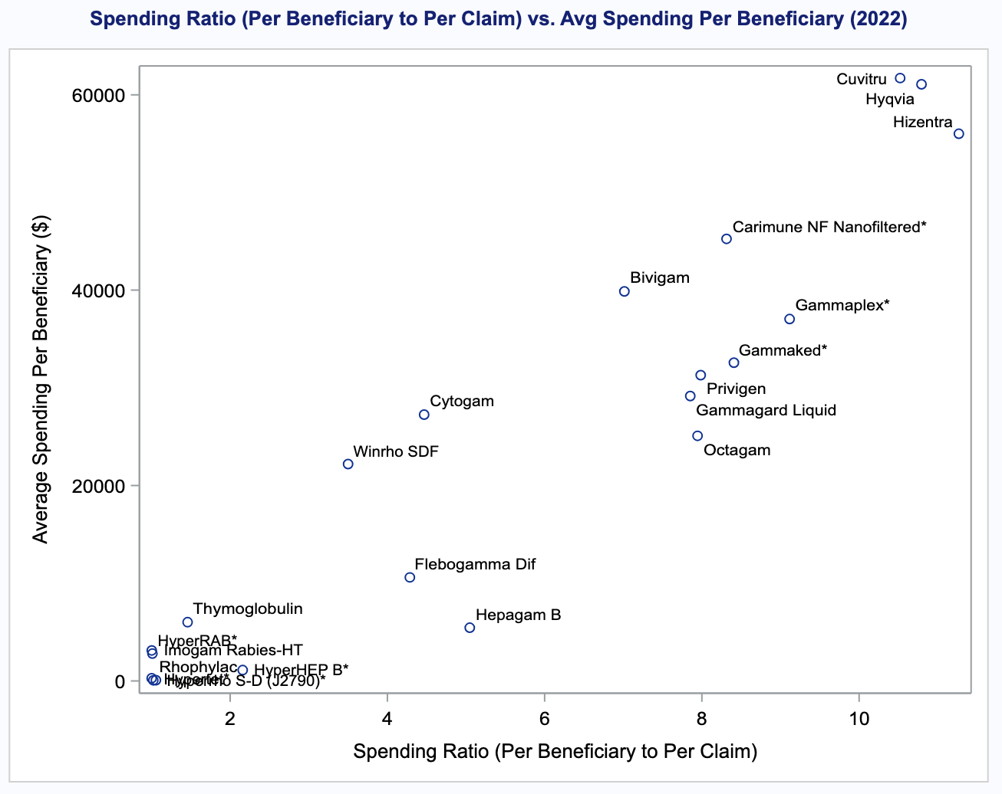
Higher spending ratios in high-cost drugs
Spending ratio (beneficiary to CMS)
Higher ratio indicates patients pay more
The linear trend suggests that patients often face disproportionately higher out-of-pocket expenses for these expensive medications.
Notes:
Here we use the amount spending for both party to calculate the spending ratio. The linear trend [animation] observed in the plot highlights that patients often face disproportionately higher out-of-pocket expenses for these expensive medications. The spending ratio reveals that patients may pay up to 10 times more than the direct claim costs covered by CMS. This indicates potential problem in Medicare’s cost-sharing policies

Slide 12
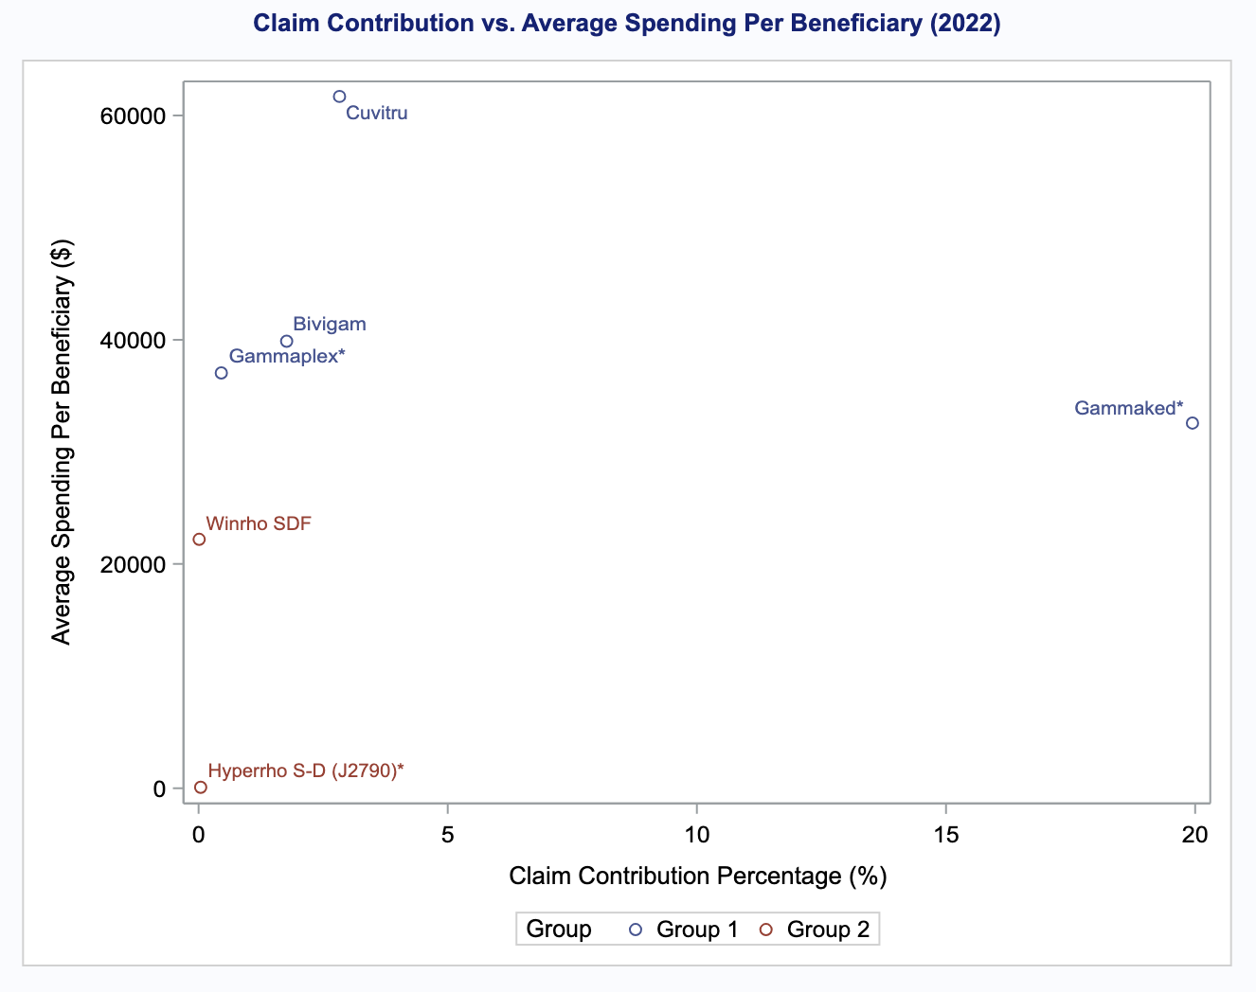
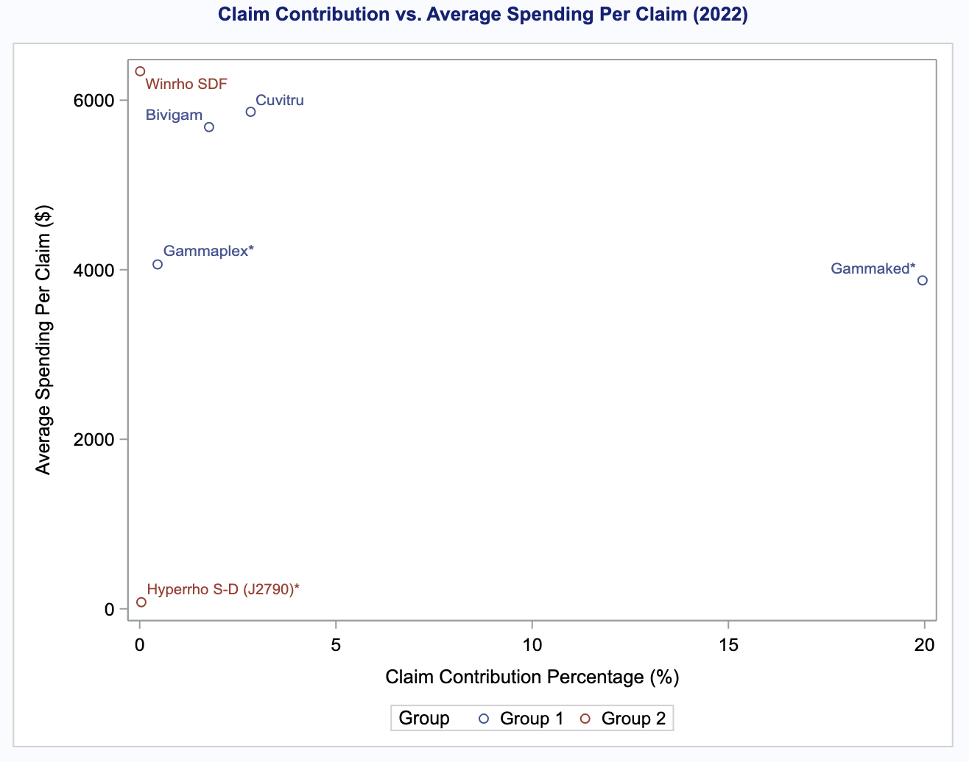
Medication Category
Categorizing IgG drugs based on medical purposes.
Intravenous Immune Globulins (IVIG)
Rho(D) Immune Globulins (RhIG)
Lower cost
Lower cost
In RhIG category, Hyperrho S-D (J2790) is the lower-cost alternative compared to Winrho SDF.
Notes:
to suggest a better policy, we categorized IgG drugs based on generic names medical purposes. The blue category is IVIG drugs, and the orange group is RhIG drugs. Here we identified that, Within the RhIG category [Animation], Hyperrho S-D (J2790) is the lower-cost alternative compared to Winrho SDF, with an approximate difference of $22,000 in average spending per beneficiary.

Slide 13
Medication Category
Categorizing IgG drugs based on medical purposes.
Intravenous Immune Globulins (IVIG)
Rho(D) Immune Globulins (RhIG)
Lower cost
Lower cost
Gammaked* accounts for 20% of the IgG drug market. Recommendations for the use of this alternative could reduce the financial burden on both beneficiaries and CMS
Notes:
As for the the IVIG group [Animation], Gammaplex* demonstrated significantly lower average spending compared to high-cost drugs like Cuvitru and Bivigam. furthermore, Gammaked* accounts for 20% of the IgG drug market. Recommendations for the use of this alternative could reduce the financial burden on both beneficiaries and CMS

Slide 14
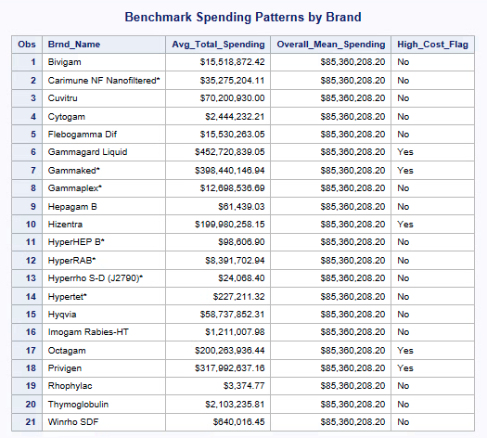


High-Cost Brands Overview
Post-Market Surveillance:
Notes:
The four brands that have significantly higher than average spending were flagged as high-cost brands, We identified five of them: Gammagard Liquid, Gammaked, Privigen, Hizentra and Octagam as their spending levels exceed the average and have a disproportionate impact on Medicare Part B spending.

Slide 15

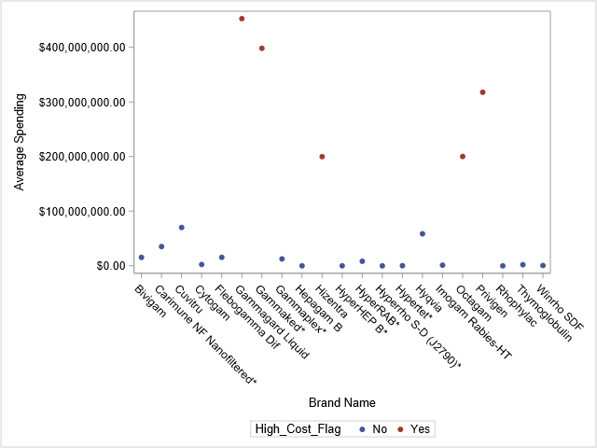
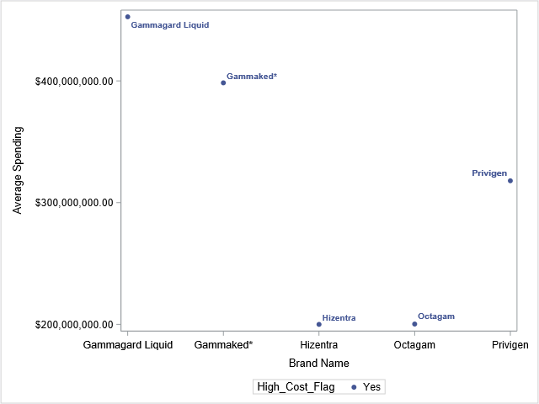
Spending Patterns of High-Cost Brands
High-cost brands marked in red
Other brands cluster near the lower spending range
Notes:
The scatterplot highlights the outliers that are the five brands that drive the spending, which we will be exploring in then next few slides

Slide 16
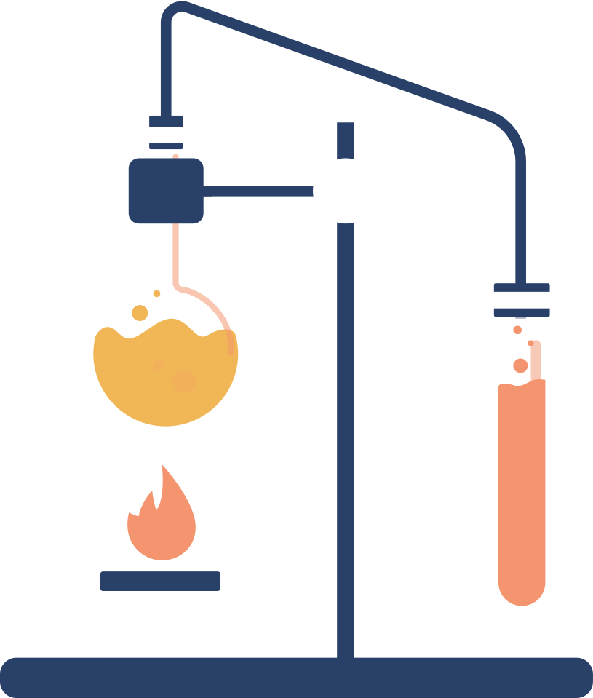
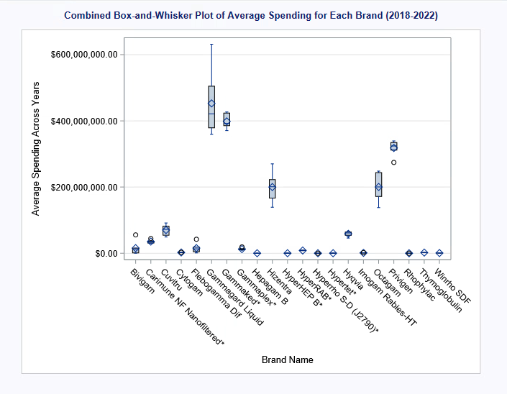
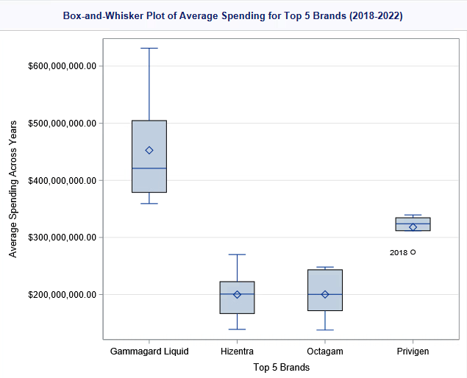
Spending Variability
Gammagard Liquid:
High average spending
Significant variability (wide interquartile range)
Notes:
The boxplots highlight spending variability, particularly for Gammagard Liquid which show both high average spending and variability. Hizentra and Octagam shows moderate variability, but they are less pronounced. Most other brands show consistently low spending, so they are not major factors in the overall high spending, but they can be promoted as alternatives to reduce financial burden.

Slide 17

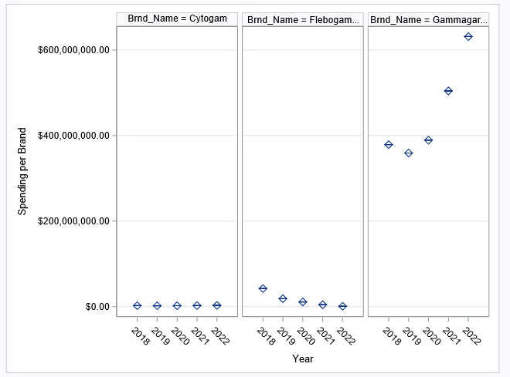
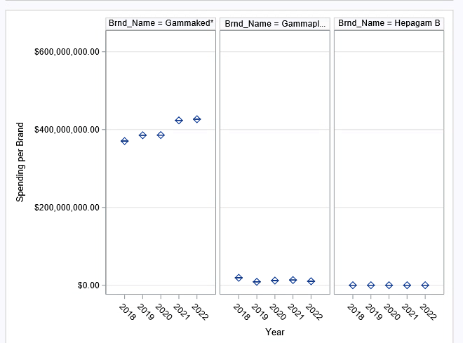
Spending Trends Over Time
Gammagard Liquid: High variability over years.
Hizentra, Octagam & Privigen: Stable but high spending.
Gammaked: Notable variability.
Notes:
The boxplots here show spending trends over time. We can see that Gammagard Liquid shows high variability. Gammaked also shows some variability, which makes these good candidates for cost stabilization efforts.

Slide 18
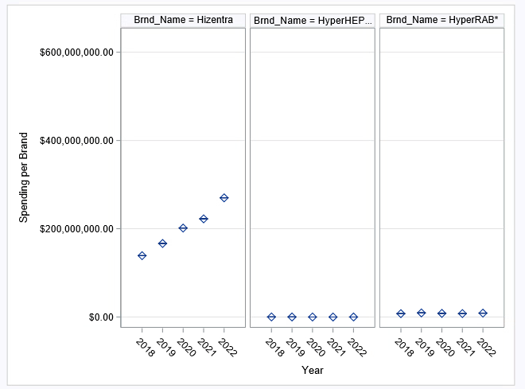
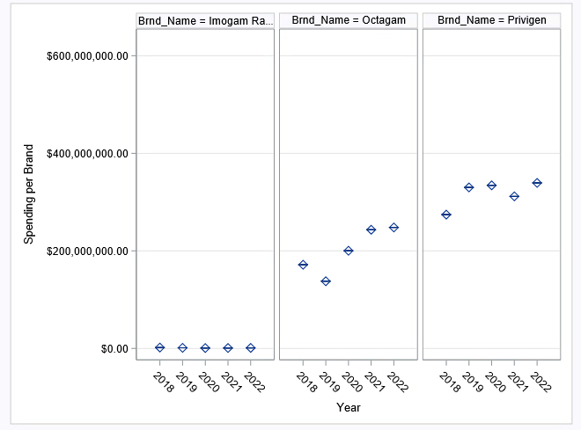
Spending Trends Over Time
Gammagard Liquid: High variability over years.
Hizentra, Octagam & Privigen: Some variability but high spending.
Gammaked: Notable variability.
Notes:
Hizentra, Octagam and Privigen have lower spending than Gammagard Liquid and Gammaked, but they do show high variability.

Slide 19
Suggestions for Future Studies
Explore Cost-Effective Alternatives | Time Series Analysis | Demographic Subpopulation Analysis | Evaluate Policy Effectiveness
Investigate therapeutic options for high-cost IgG drugs Identify alternative formulations to reduce financial burdens | Analyze spending trends over extended periods. Monitor economic effects (e.g., inflation, recession) on drug spending | Examine spending patterns among low-income beneficiaries and rural populations with limited resources | Assess how implemented policies influence spending
Notes:
Using the techniques presented in this project highlights the need for future research on alternatives to high-cost drugs and offers cost containment strategies for beneficiaries and CMS. As more data is collected each year, a more accurate forecast can be calculated, which can provide more detailed information as to how spending will change rather than just showing an upward trend. This can also be used to see the effect of any policies that are implemented to minimize excessive costs for these drugs, which could potentially decrease Part B spending.
Future studies could analyze how IgG spending trends affect specific Part B subpopulations such as those with lower socioeconomic status or populations in rural areas with lack of medical resources. Lastly, additional research could impact the implementation of policies and be helpful in determining whether they are influential to Part B beneficiaries while also keeping CMS financially sustainable.

Slide 20
Conclusions
1
2
3
Key Findings
Recommendations
Future Outlook
Increased spending over the years
Utilization of high-cost drugs
Presence of high spending by beneficiaries
Identification of cost-effective alternatives within therapeutic groups
Price ceilings
Promotion of generic medication alternatives
Ensure plasma supply chains are stable
With implementation of recommendations:
Improve affordability
Improve accessibility
Financial stability for both beneficiaries and CMS.
Notes:
The study of Part B spending on IgG highlighted critical issues related to affordability and utilization on specific drugs. Increased spending over the years, utilization of high-cost drugs such as Gammagard Liquid and Gammaked*, and presence of high spending by beneficiaries can determine which policies CMS needs to focus on to increase affordability for their beneficiaries.
Implementing policy changes such as price ceilings and promotion of generic medication alternatives will allow for CMS to improve affordability and accessibility for their beneficiaries without compromising their financial stability.

Slide 21

Contact us:
Abigail Davis - abigail.davis@my.utsa.edu
Rani Misra - rani.misra@my.utsa.edu
Kashfia Sharmin - kashfia.sharmin@my.utsa.edu
Cheryl Chiu - cheryl.chiu@my.utsa.edu
Questions?

Slide 22
Citations
The Centers for Medicare and Medicaid Services. (2024, July). Medicare monthly enrollment.
https://data.cms.gov/summary-statistics-on-beneficiary-enrollment/medicare-and-medicaid-reports/medicare-monthly-enrollment/data?query=%7B%22filters%22%3A%7B%22list%22%3A%5B%7B%22conditions%22%3A%5B%7B%22column%22%3A%7B%22value%22%3A%22YEAR%22%7D%2C%22comparator%22%3A%7B%22value%22%3A%22%3D%22%7D%2C%22filterValue%22%3A%5B%222018%22%5D%7D%5D%7D%5D%2C%22rootConjunction%22%3A%7B%22value%22%3A%22AND%22%7D%7D%2C%22keywords%22%3A%22%22%2C%22offset%22%3A0%2C%22limit%22%3A10%2C%22sort%22%3A%7B%22sortBy%22%3Anull%2C%22sortOrder%22%3Anull%7D%2C%22columns%22%3A%5B%22YEAR%22%2C%22B_TOT_BENES%22%5D%7D
Lu, R., Hwang, Y., Liu, I., Lee, C., Tsai, H., Li, H., & Wu, H. (2020, January 02). Development of therapeutic antibodies for the treatment of diseases. Journal of Biomedical Science, 27(1). https://jbiomedsci.biomedcentral.com/articles/10.1186/s12929-019-0592-z
Hartmann, J., & Klein, H. G. (2020, September 09). Supply and demand for plasma-derived medicinal products - A critical reassessment amid the COVID-19 pandemic. Transfusion 60(11), 2748-2752. https://pmc.ncbi.nlm.nih.gov/articles/PMC7460929/

